Slide 1
Generic OS services

Slide 2
INDEX
Introduction
Operating System interfaces
Time access and conversions
Command line option parser

Slide 3
INTRODUCTION
The module “os” provide interfaces to operating system.
There are number of methods, attributes available in the module to access OS environment, getting OS related information, running OS command such as get the current working directory, change the directory, etc..
All functions in this module raise OSError in the case of invalid or inaccessible file names and paths, or other arguments that have the correct type, but are not accepted by the operating system.

Slide 4
OPERATING SYSTEM INTERFACES
os.environ:
A mapping object representing the string environment. For example, environ['HOME'] is the pathname of your home directory (on some platforms), and is equivalent to getenv("HOME") in C.
If the platform supports the unsetenv() function, you can delete items in this mapping to unset environment variables. unsetenv() will be called automatically when an item is deleted from os.environ.

Slide 5
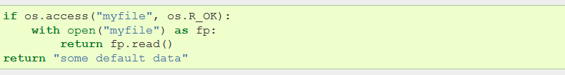
OPERATING SYSTEM INTERFACES
Note:
I/O operations may fail even when access() indicates that they would succeed, particularly for operations on network file systems which may have permissions semantics beyond the usual POSIX permission-bit model.

Slide 6
OPERATING SYSTEM INTERFACES
  os.getenv(varname[, value])
  Return the value of the environment variable varname if it exists, or value if it doesn’t. value defaults to None
  os.putenv(varname, value)
  Set the environment variable named varname to the string value. Such changes to the environment affect subprocesses started with os.system(), popen() or fork() and execv().

Slide 7
OPERATING SYSTEM INTERFACES
os.mkdir(path[, mode])
  Create a directory named path with numeric mode. The default mode is 0o777 (octal). On some systems, mode is ignored. Where it is used, the current umask value is first masked out. If the directory already exists, OSError is raised.
  os.rmdir(path)
  Remove (delete) the directory path. Only works when the directory is empty, otherwise, OSError is raised.

Slide 8

TIME ACCESS AND CONVERSIONS
  This module provides various time-related functions. Although this module is always available, not all functions are available on all platforms. Most of the functions defined in this module call platform C library functions with the same name.

Slide 9
COMMAND LINE OPTION PARSER
“optparse” is a more convenient, flexible, and powerful library for parsing command-line options than the old getopt module. It uses a more declarative style of command-line parsing.
It allows users to specify options in the conventional GNU/POSIX syntax, and additionally generates usage and help messages for you.
It was explicitly designed to encourage the creation of programs with straightforward, conventional command-line interfaces. To that end, it supports only the most common command-line syntax and semantics conventionally used under Unix.

Slide 10
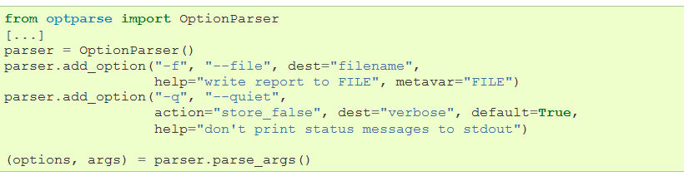

COMMAND LINE OPTION PARSER
First, you need to import the “OptionParser” class; then, early in the main program, create
an “OptionParser” instance:

Slide 11

COMMAND LINE OPTION PARSER
Then you can start defining options. The basic syntax is:
Each option has one or more option strings, such as -f or --file, and several option attributes that tell optparse what to expect and what to do when it encounters that option on the command line.
Typically, each option will have one short option string and one long option string, e.g.:

Slide 12
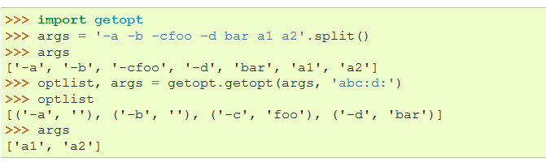
COMMAND LINE OPTION PARSER
This module helps scripts to parse the command line arguments in sys.argv. It supports the same conventions as the Unix getopt() function (including the special meanings of arguments of the form ‘-‘ and ‘--‘).
An example using only Unix style options:

Slide 13
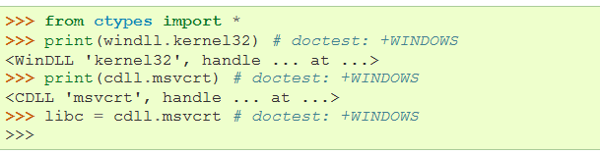
COMMAND LINE OPTION PARSER
ctypes is a foreign function library for Python. It provides C compatible data types, and allows calling functions in DLLs or shared libraries. It can be used to wrap these libraries in pure Python.
ctypes exports the cdll, and on Windows windll and oledll objects, for loading dynamic link libraries.
Here are some examples for Windows
Note: Windows appends the usual .dll file suffix automatically.

Slide 14
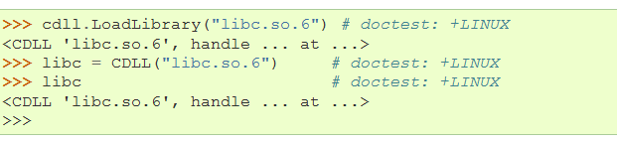
COMMAND LINE OPTION PARSER
On Linux, it is required to specify the filename including the extension to load a library, so attribute access can not be used to load libraries. Either the LoadLibrary() method of the dll loaders should be used, or you should load the library by creating an instance of CDLL by calling the constructor

